Slide 1


Master of Technology (IS)
Pepper Project Group
CAO LIANG | A0012884E
GENG LIANGYU | A0195278M
HAN DONGCHOU FRANCIS | A0195414A
ONG BOON PING | A0195172B
TAN CHIN GEE | A0195296M
Depression Screening System
Depression Screening System
Project Report

Slide 2
Contents
Executive Summary 3
Business Problem Background 4
Project Objectives & Success Measurement 5
Project Solution 6
Solution Design 8
Project Implementation 11
Project Performance & Validation 18
Project Conclusions: Findings & Recommendation 23

Slide 3
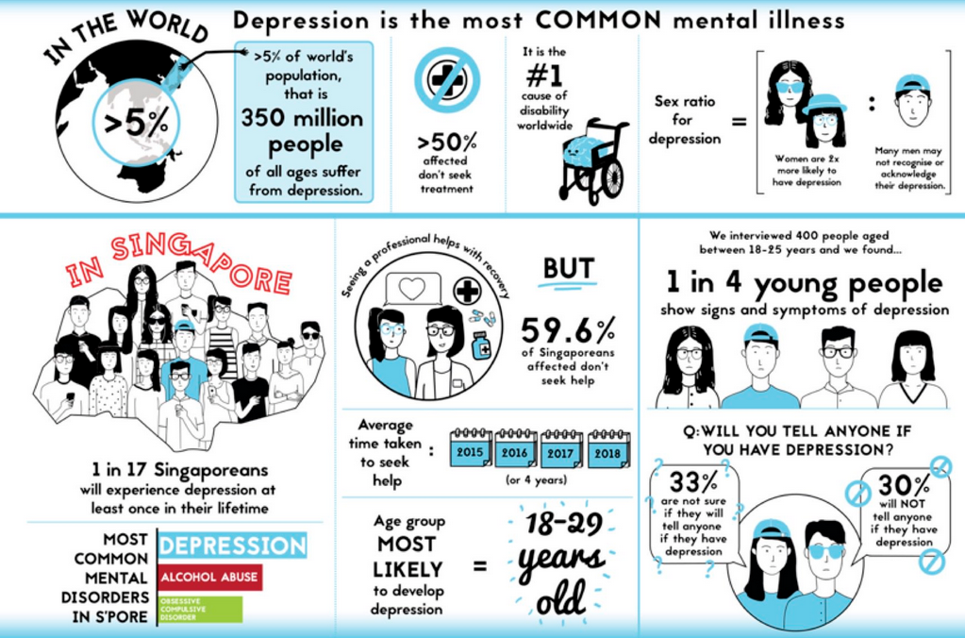
Executive Summary
Many young Singaporeans show signs of depression. IMH treated 600 youths between 20 to 29-years-old last year alone. And one out of four people admitted to suffering from multiple symptoms of depression in a recent survey of youths aged 18 to 25. The study was conducted by students from Wee Kim Wee School of Communication and Information in NTU. We know that depression may lead to suicide. But other times, its sufferers become less productive and are more at risk for other diseases. The latest statistics on depression don’t paint a pretty picture of progress but it shows that the condition is more common than we think. Yet the stigma surrounding it walls off the victim who often suffers in silence. We need to seek out those who need help, and help them early. However, the challenge is that we do not have enough practitioners to do that.
This project serves to help Singapore tackle the immense problem of depression as well we alleviate the lack of practitioners to seek out those who need help. Using AI, we are trying to take a pro-active stand to detect depression condition in certain high-risk groups amongst the population, and as early on as possible. We leveraged tools like KIE Workbench, the Spring Boot etc to put together a framework for the application. This application can be used to seek out those who need professional assistance.

Slide 4
Business Problem Background
Depression is a chronic illness often with episodes lasting months and high rates of relapses. It is known to cause the patient much suffering, the family distress and significantly increase the risk of suicide. Most people with depression will seek help from their family doctors. Sometimes, they present to the doctors with only physical symptoms such as headaches, chest pains or body ache. This form of presentation is particularly common in people with chronic illness as well as in teens and the elderly. As a result, depression can often be masked and the diagnosis of depression may be missed or disregarded.
Severe depression can be readily recognized but it may be difficult to distinguish milder form of depression from emotional changes associated with everyday life. Life stresses such as job loss, divorce, and the death of a loved one can result in a sad mood of short duration. Clinical depression or Major Depressive Disorder develops when depressed mood becomes much worse and persistent and is accompanied by other symptoms and lasts for more than two weeks. When depressed, a person may start to have difficulties with his sleep. He feels unmotivated and will no longer be interested in his work and the usual things he liked. He can also have problems with his appetite and weight. When performing activities, he has little energy and cannot concentrate. He may feel guilty about things he has done wrong and ruminate excessively about the past. When the depression becomes more severe, he will feel that life is hopeless and may contemplate or even attempt suicide. Patients tell us that when they are suffering from Major Depressive Disorder, it is like wearing a pair of shades that cannot be removed and everything looks dark and gloomy.
Oftentimes, people with depression do not get help early enough or are not detected until its too late.
Given that the high risk groups are well studied and documented, and the symptoms are well known, we should be able to do better to improve the situation.

Slide 5
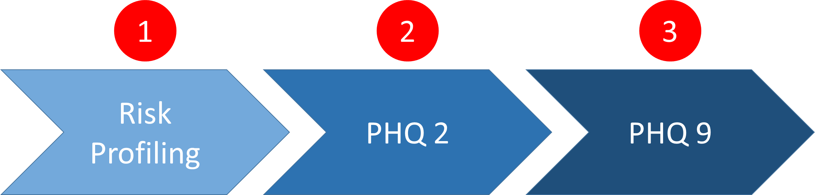
Project Objectives & Success Measurement
We need to seek out those who need help, and help them early. However, the challenge is that we do not have enough practitioners to do that.
One way to tackle this problem is to adopt a pro-active approach to seek out those who need professional assistance. The objective of this project serves to do just that with the help of Artificial Intelligence.
With AI, we could apply some techniques like Certainty Factor, Decision Tree, and Inference Diagram to automate the screening of candidates. The screening is done at three levels:
Identifying the high risk group – Risk Profiling
Doing a 2-question survey (PHQ2)
Doing a 7-question survey (PHQ9)
Level #1 can be applied to any organization, be it a school, a workplace, or even just targeting a segment of people. Once level #1 is done, those identified candidates can proceed to Level #2 and level #3 in a survey setting so that we can ascertain whether the candidate would likely be suffering from depression, and then recommending the next steps.
Success Measurement for this application would be based on its ability to flag a high risk individual as well as computing the score pertaining to the level of depression.
Notes:
One in four young Singaporeans show signs of depression. IMH treated 600 youths between 20 to 29-years-old last year alone.
And one out of four people admitted to suffering from multiple symptoms of depression in a recent survey of youths aged 18 to 25. The study was conducted by students from Wee Kim Wee School of Communication and Information in NTU.
We know that depression may lead to suicide. But other times, its sufferers become less productive and are more at risk for other diseases.
The latest statistics on depression don’t paint a pretty picture of progress but it shows that the condition is more common than we think. Yet the stigma surrounding it walls off the victim who often suffers in silence.
We need to seek out those who need help, and help them early. However, the challenge is that we do not have enough practitioners to do that.
One way to tackle this problem is to adopt a pro-active approach to seek out those who need professional assistance. The objective of this project serves to do just that with the help of Artificial Intelligence. With AI, we could apply some techniques like Certainty Factor, Decision Tree, and Inference Diagram to automate the screening of candidates. The screening is done at three levels:
Identifying the high risk group – Risk Profiling
Doing a 2-question survey (PHQ2)
Doing a 7-question survey (PHQ9)
Level #1 can be applied to any organization, be it a school, a workplace, or even just targeting a segment of people.
Once level #1 is done, those identified candidates can proceed to Level #2 and level #3 in a survey setting so that we can ascertain whether the candidate would likely be suffering from depression, and then recommending the next steps.

Slide 6

Project Solution
RISK PROFILING
In a survey done by the Annals Academy of Medicine Singapore from December 2009 to December 2010, some focus was placed on the profile of people who are at higher risking of suffering from depression.
The five indicators used for determining the risk profile are shown below.
This application will do the screening to assess if the candidate belongs to the high risk group. If so, he/she will proceed with the PHQ9 assessment.
Chronic Physical Condition
Marital Status
Ethnicity
Gender
Age
Chong, S. A., Abdin, E., Vaingankar, J. A., Heng, D., Sherbourne, C., Yap, M., … Subramaniam, M. (2012). A population-based survey of mental disorders in Singapore. Annals Academy of Medicine Singapore, 41, 49-66.

Slide 7
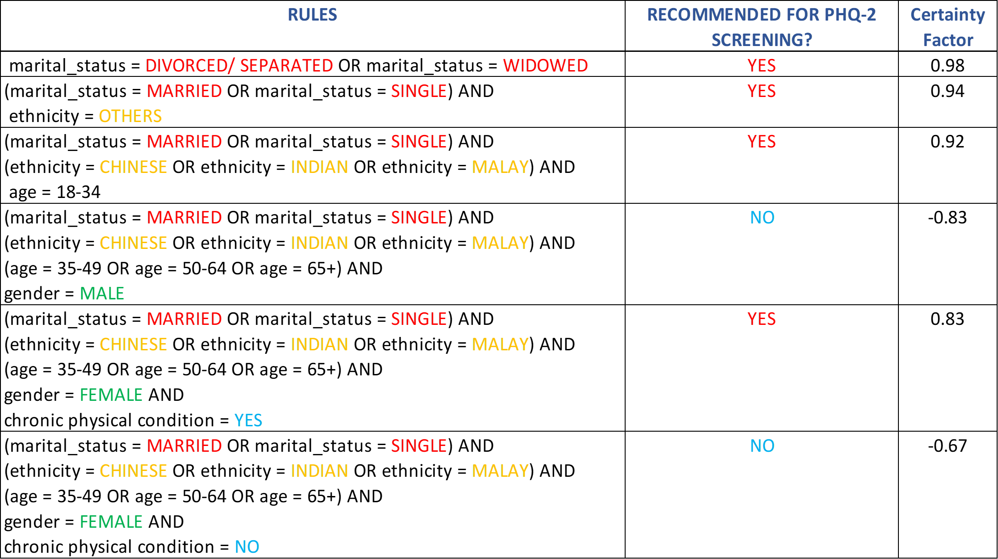
Project Solution
RISK PROFILING
Based on the survey done by the Annals Academy of Medicine Singapore, a table of Certainty Factors against each indicator is drawn up as follows.
From this table, we could see that the female gender is more prone to depression than male. Ethnicity also plays a part in that the mixed race (under Others) are a more susceptible group. Also, Singles are slightly less prone than Married people, whereas those who are divorced, separated, or widowed find themselves at risk. Among the different age group, the one that has the highest Certainty Factor is between 18 and 24 years old. As for those with chronic physical condition, they are at risk too.
Using this information, we have incorporated the Certainty Factors into our logic for assessing if an individual belongs to the high risk group. This is part of the Risk Profiling function that the application performs.

Slide 8
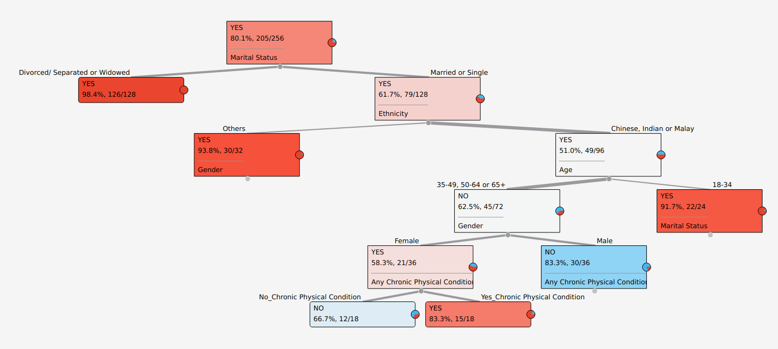
Solution Design
Using the Decision Tree, the assessment is carried out to determine whether the candidate belongs to the higher risk group. If so, this candidate will go on to the PHQ-2 survey.

Slide 9
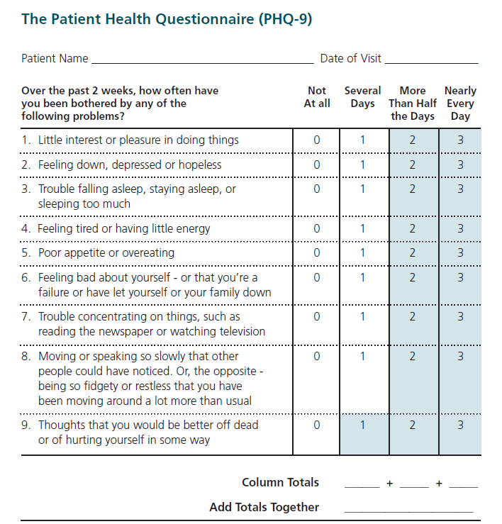
Solution Design
FrameworkAdopted PHQ9
The PHQ-9 is a multipurpose survey for screening, diagnosing, monitoring and measuring the severity of depression. It is completed by the patient in minutes and is typically scored by the clinician. Scores of 5, 10, 15 and 20 represents mild, moderate, moderately severe and severe depression.
PHQ-2 comprises the first two questions of PHQ-9. When the candidate’s response to the survey is less than 2 for both questions, then the candidate will not need to proceed with the survey. If any of the two questions has a score of 2 or more, then the rest of the survey questions must be completed.

Slide 10
Solution Design - PHQ9 in Detail

Slide 11
Project Implementation
Data Setup

Slide 12
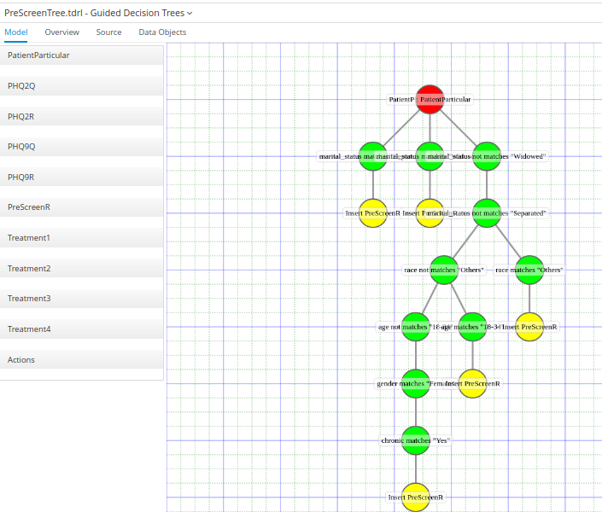
Project Implementation
Guided Decision Tree
Using the Guided Decision Tree in the KIE Workbench, the Risk Profiling logic is mapped out to assess whether a candidate falls into the High Risk category. If so, the candidate would go on to the next survey, that is the PHQ2.
Two roles are created for the application:
Patient1
Dr Hong – mental health practitioner

Slide 13
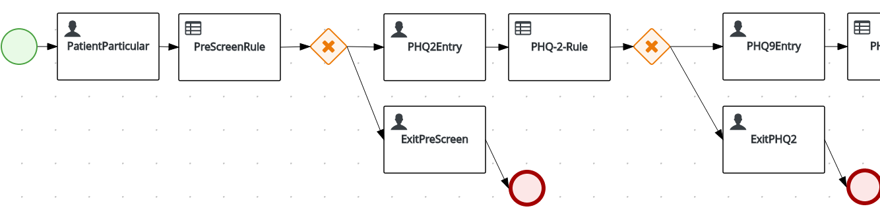
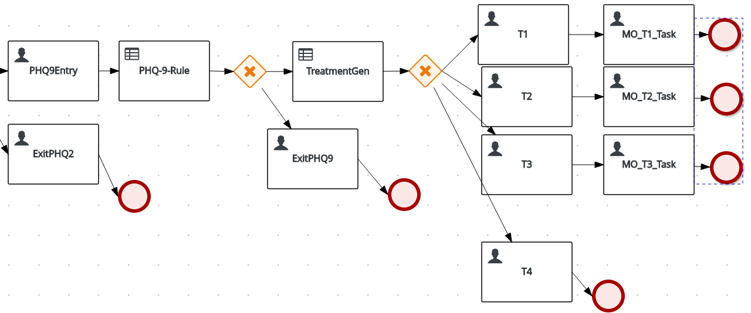
Project Implementation
Process Flow
Using the KIE Workbench, a Process Flow is created to map the various points of inference and assessments based on the Risk Profiling, PHQ-2 and PHQ-9 survey entries.
The logic engine performs in a way that determines if the candidate exhibit any symptom which may indicate a possibility of depression.

Slide 14
Project Implementation
Risk Profiling
The process flow starts with a pre-survey check to determine if the candidate belongs to the High Risk group.
In this flow, the actor Patient1 keys in his particulars.
This Patient Particular will be pre-screened using rules generated from data mining.
In the rule, the fact will be inserted only if the conditions are met. Otherwise, the flow will send a message to the user to indicate that he/she is clear and does not need to proceed with PHQ2.
If the fact is inserted, Q1 and Q2 of PHQ2 will be presented to task actor Patient1.

Slide 15
Project Implementation
PHQ-2
The PHQ-2 rule will then be invoked.
PHQ-2 screens the candidate to determine whether the following two symptoms occur :
Loss of interest in things
Feeling down
If Q1 or Q2 scores 2 or more, the flow will proceed to PHQ9. Else, a message will be sent to Patient1 to indicate that he/she is clear and the flow ends.

Slide 16
Project Implementation
PHQ-9
PHQ-9 goes into further detail of assessment. The logic behind PHQ-9 is such that the candidate will be sorted into four categories of severity depending on the overall score computed for the survey.
The result will be assessed. If 5 questions are scoring more than 2 each (except for Q9, the threshold mark is set to more than 1), then proceed. If not, a message will be sent to Patient1 to indicate that the flow is ended with no problem detected.
The TreatmentGen rule task will then compute the total score. The total score will determine which of the treatment level in the 4 leves of treatment is chosen.
Treatment level 4 is least severe, user will be given message to advice taking PHQ9 again later.
For Treatment level 1,2,3, Patient 1 will be given advice to seek doctors health. The medical officer will be triggered after Patient1 read the message. The medical officer will then key in the treatment required based on different level of message that he received in the task inbox.
After medical officer read give the treatment, the flow is completed.

Slide 17
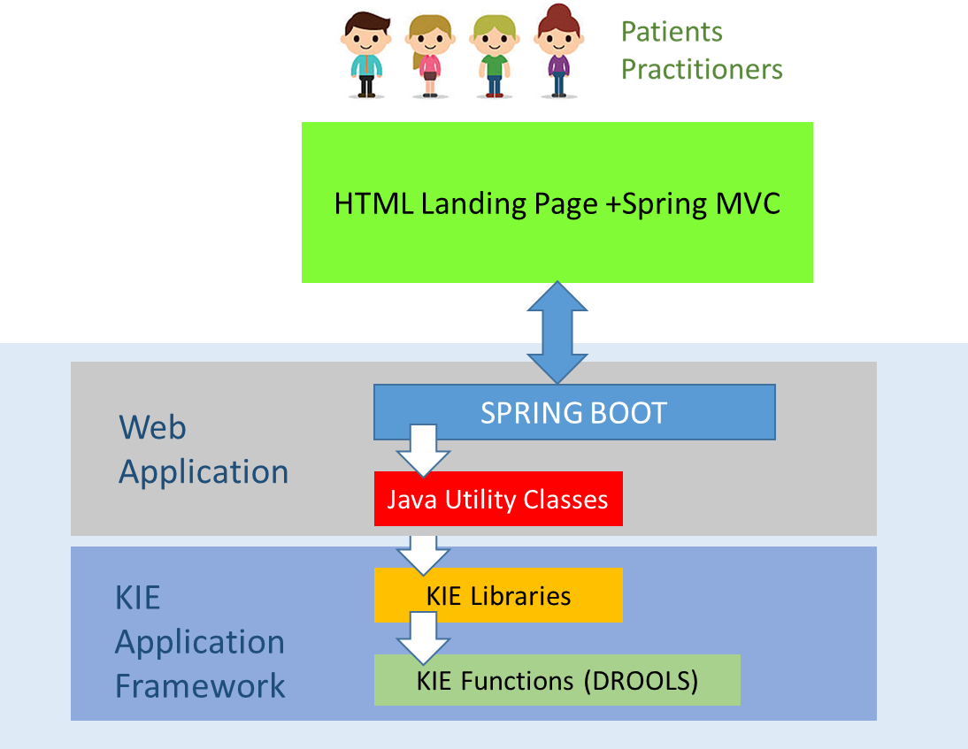
Project Implementation
Architecture
This application leverages the KIE Workbench as the main framework for development and deployment. With the KIE Workbench, we utilize the JBPM for metadata and workflow, DROOLS for rules engine and the JBOS Web Server to provide the web application server functions. In addition, we are using the Spring Boot to program the landing page, front-end screens and interface with KIE.
A lot of effort was spent on integrating the Spring Boot web application with the KIE framework through our self-coded Java classes.
This allows the user to not only interface with an external HTML page but also stay on the HTML frontend throughout the entire process. Behind this frontend, our custom built web application interfaces with the KIE libraries via the Java classes.

Slide 18
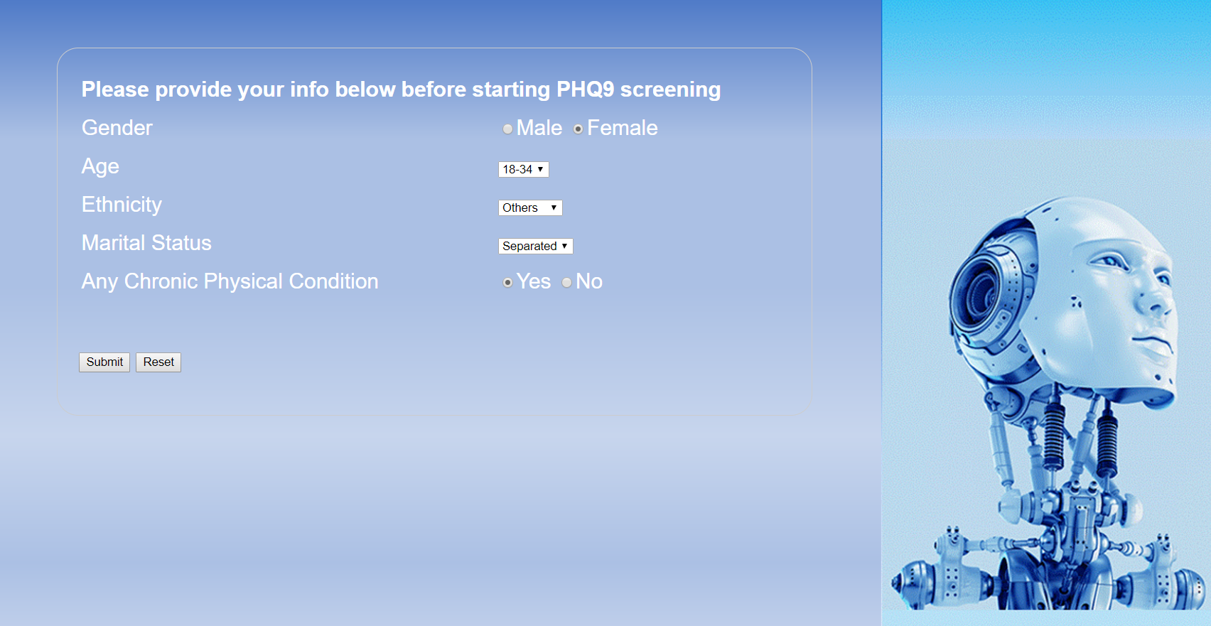
Project Performance & Validation
As mentioned in this document, Success Measurement for this application would be based on its ability to flag a high risk individual as well as computing the score pertaining to the level of depression.
During our test of the system, we simulated a survey done on a candidate. The following describes the entire test flow.
1. Risk Profiling
The candidate first of all performs the Risk Profiling in which the 5 risk factors (Age, Gender, Ethnicity, Marital Status and Chronic Physical Condition) are covered.
Given that the input during this test run corresponds to the high risk group, candidate proceeds with PHQ2.

Slide 19
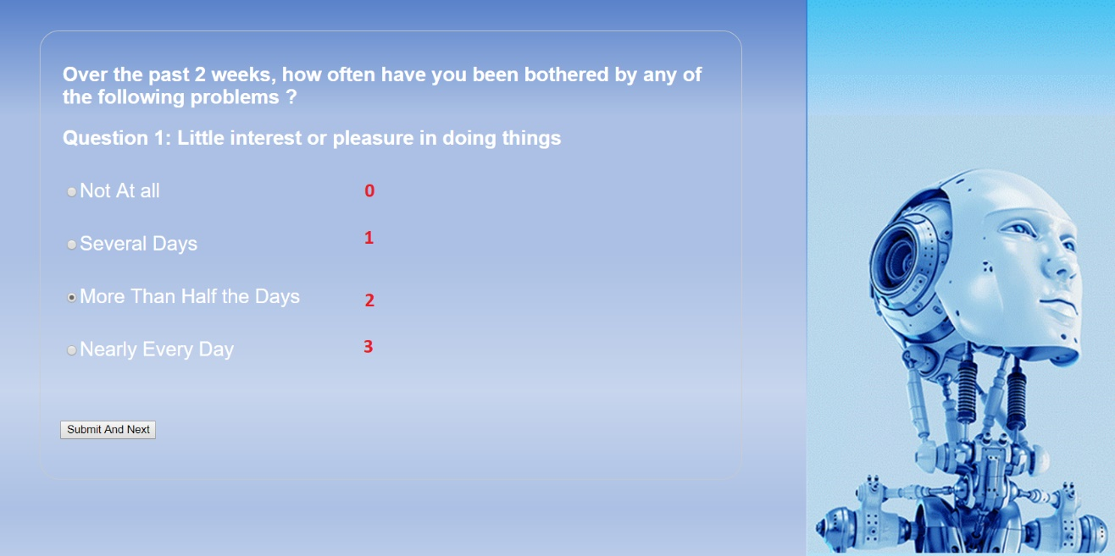
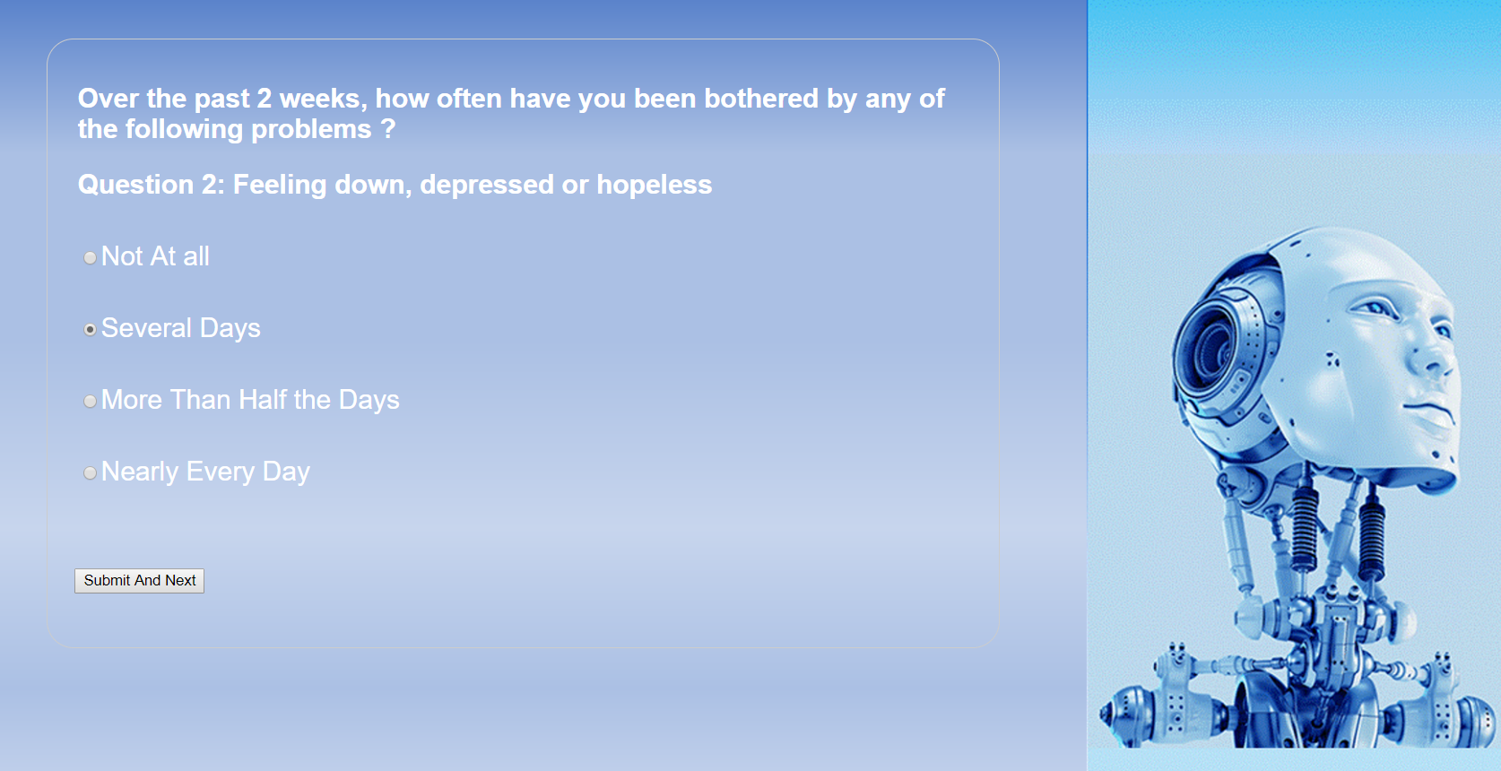
Project Performance & Validation
2. PHQ2
Next, the candidate answers the first 2 questions of PHQ9 (called PHQ2). The answers are given such that there are symptoms of depression. The system is able to assess that this candidate needs to proceed with PHQ9.

Slide 20
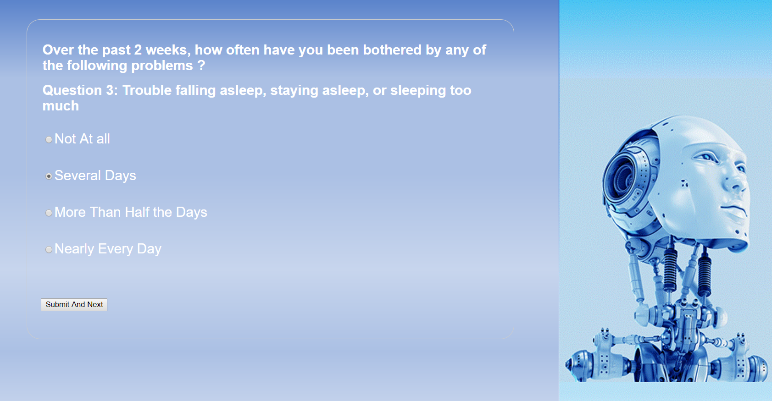
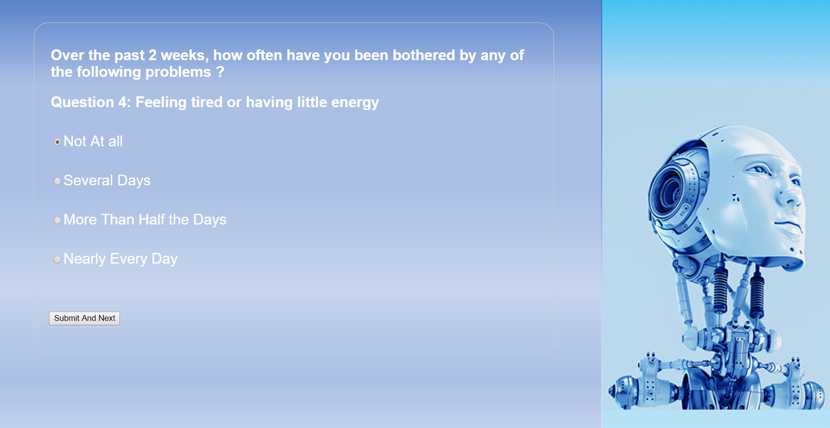
Project Performance & Validation
3. PHQ9
In PHQ9, the candidate gets to answer all the 7 questions as depicted in the following screens.

Slide 21
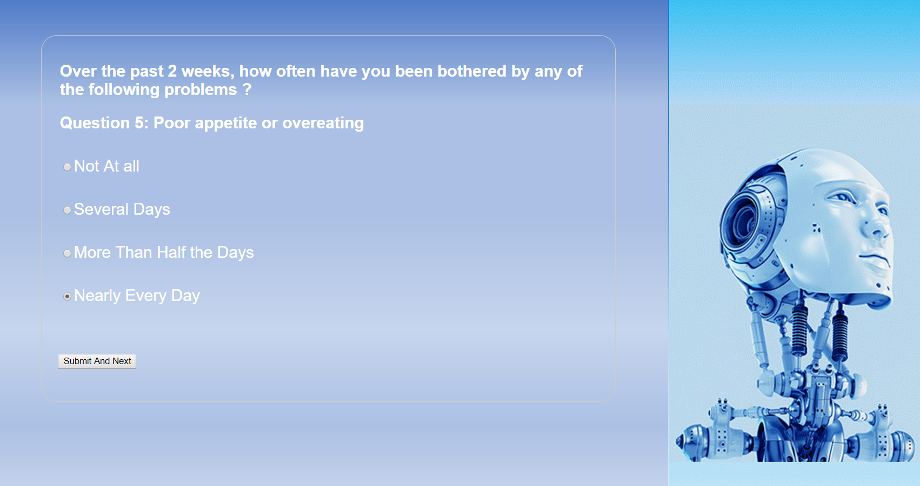
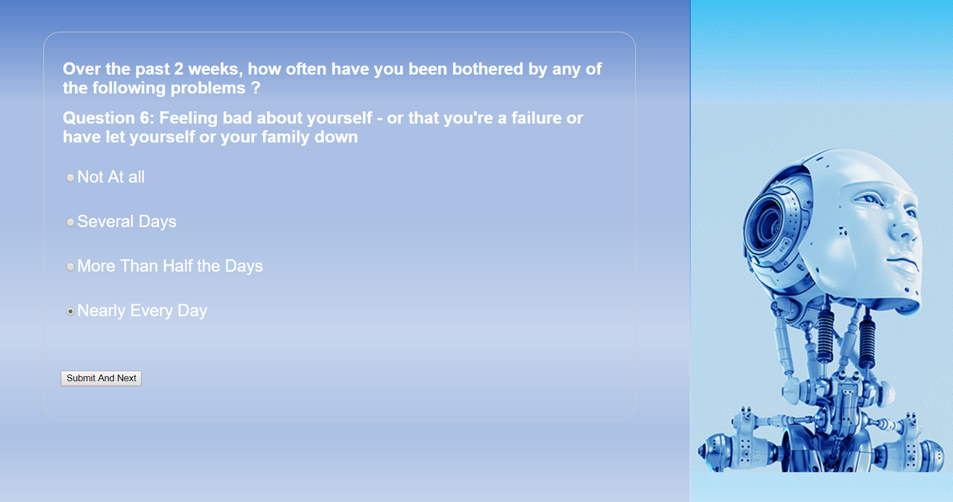
Project Performance & Validation
3. PHQ9

Slide 22
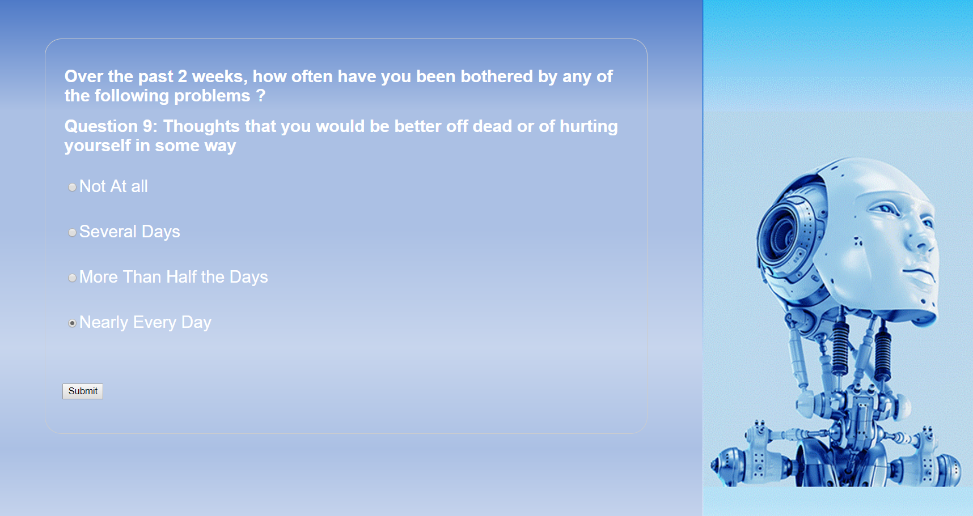
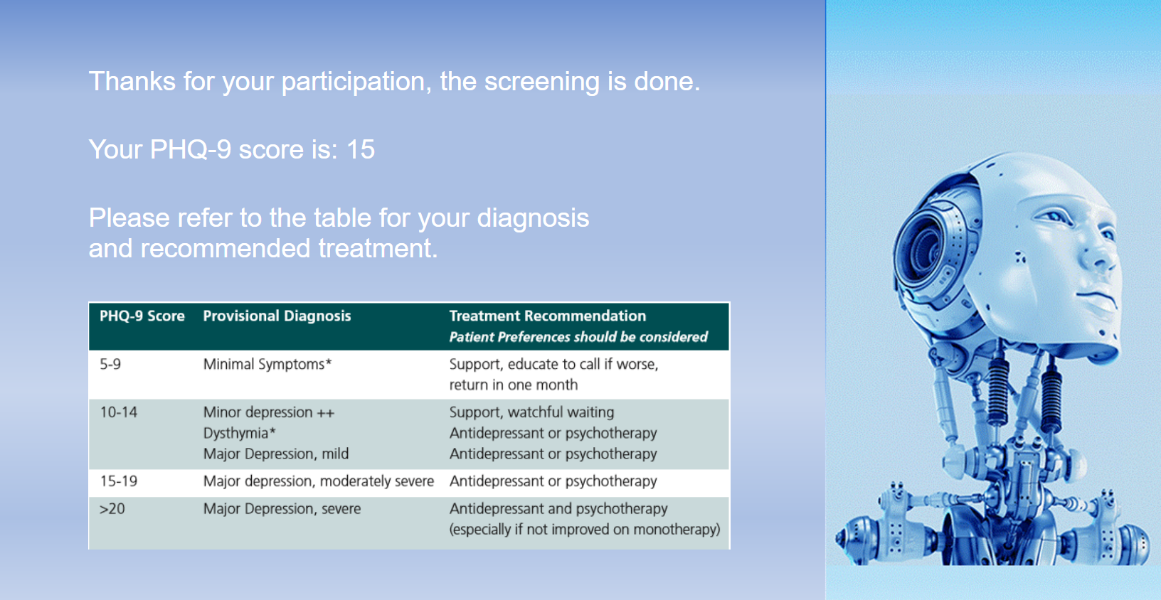
Project Performance & Validation
3. PHQ9
At the end of PHQ9, a screen showing the result of the survey is displayed. This is accompanied with the diagnosis table which contains the corresponding recommendations.
The score is consistent with the computation logic and in line with the entries given by the candidate. Given that the entries are skewed towards a moderately severe level of depression, the ensuing score and recommendation is consistent with the expected result.
We deem the test successful in that this high risk candidate with a moderately severe depression is flagged for the PHQ9 survey and is assessed accurately.

Slide 23
Project Conclusions: Findings & Recommendation
From this project, we are able to put some of the AI techniques to practice. The techniques are Certainty Factor, Decision Tree and Inference Diagram. In addition, this project demonstrates the many possibilities that AI can be put to good use. This use case involving helping people with depression is one of the things we can do for people with mental illness which is becoming more prevalent in our societies.
In this respect, our application can play a useful role to adopt a proactive approach in helping people with depression and treating them earlier. We recommend that schools of higher learning and places with concentration of youths consider using this tool for screening.
At the same time, this application has the potential to be extended with more functionalities and our team look forward to doing that as we learn new techniques in this course at ISS NUS.

